Slide 1
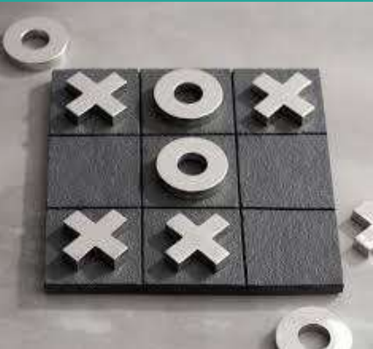
DSCI-6612-02 Intro to Artificial Intelligence Tic-Tac-Toe
Professor:
Vahid Behzadan
Team Members:
Nithish Kumar Mayavan
Jayakrishna Chinthaginjala

Slide 2
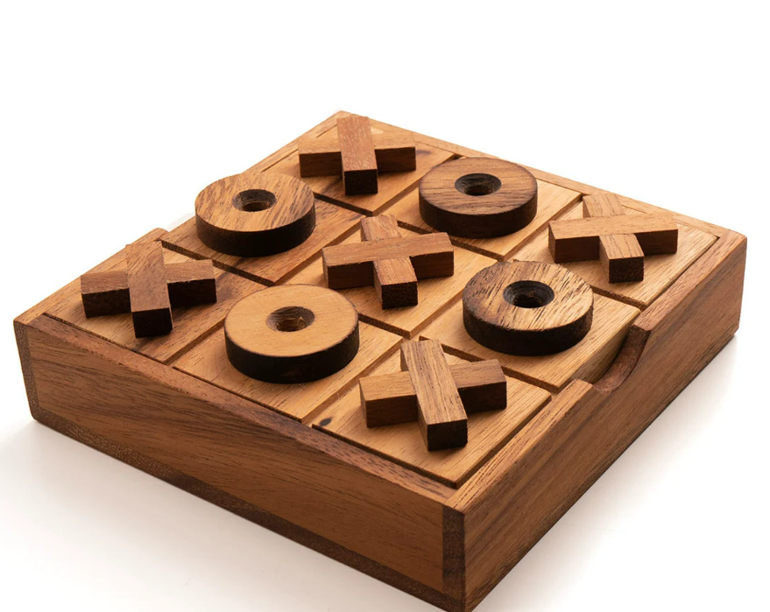
Project Topic
Game of Strategy
Two participants take turns placing X or O symbols on a 3x3 grid, aiming to form a winning sequence of three marks horizontally, vertically, or diagonally.
Key Concepts
Knowing the possibility of various outcomes is known as probability.
The ability to use strategic planning and anticipation in decision-making is known as predictability.

Slide 3

Objectives
Developing a Tic-Tac-Toe adversarial search algorithm.
AI Design Agents
Min-Max Algorithm
Alpha-Beta Pruning
Determine the best tactic for Tic Tac Toe by iteratively testing algorithms.
To decide whether the algorithm performs better adversarial search define performance metrics for each method and compare the outcomes.

Slide 4
Statement of Project Objectives
The primary objective of this project is to implement an Artificial Intelligence (AI) capable of playing Tic-Tac-Toe optimally using the Minimax algorithm.
The user can choose which two agents will compete in a Tic-Tac-Toe tournament.
The logic of the game is Agent wins against User or User wins against Agent or Tie between Agent and User.

Slide 5
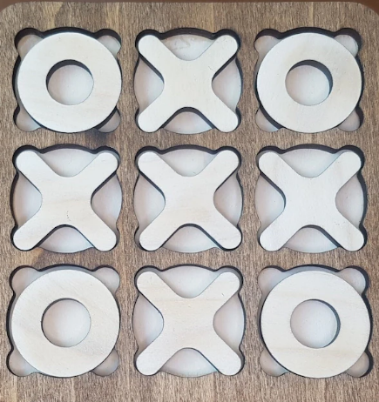

AI Approaches for Tic-Tac-Toe
Adversarial Search Strategies
Implementing Adversarial Search Strategies as our second approach.
Min-Max Algorithm
Alpha-Beta Pruning
Chosen Language
Python

Slide 6

Deliverables
The Tic Tac Toe game implementation using Min-Max and Alpha-Beta is described in detail in the User Documentation model.
Python programming language was used to create algorithms for AI Agents (.py files)
Link to the Python code and related files on GitHub.
A YouTube video that shows how the project is implemented with slides

Slide 7

Evaluation Methodology
The execution of every AI agent is the basis for project evaluation.
To identify the most effective agent, determine how many times the corresponding agent has won by playing one-on-one.
A table that compares the three agents based on their win percentage, Tic Tac Toe moves, and corresponding scores.
Charts showing the differences in performance.
Comparing the three agents' time and space complexity

Slide 8
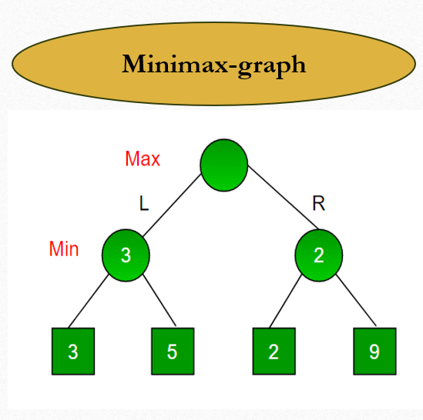
Min-Max Algorithm
Minimax is a decision-making algorithm used in two-player games to minimize the possible loss in a worst-case scenario.
Minimax works by recursively exploring the game tree to evaluate possible moves and outcomes.
In this algorithm two players play the game, one is called MAX and another is called MIN.

Slide 9
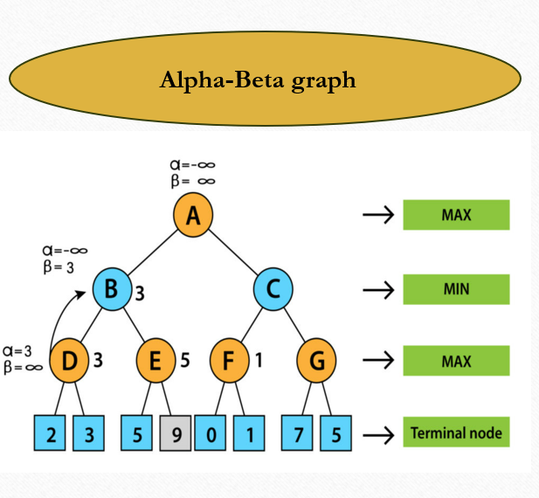
Alpha-Beta Pruning
Alpha is the best value that the maximizer currently can guarantee at the level or above.
Beta is the best value that the minimizer currently can guarantee at the level or above.
Alpha-Beta Pruning optimizes decision-making in games by skipping unnecessary branches in a decision tree. It utilizes Alpha and Beta values to identify and prune branches during the search, reducing computational effort while finding the optimal move.

Slide 10
How is Our Tic-Tac-Toe Game Different?
This project aims to implement an AI for optimal Tic-Tac-Toe gameplay using the Minimax algorithm, ensuring strategic decision-making for unbeatable performance against human opponents.
Additionally, the project seeks to enhance AI efficiency by optionally integrating Alpha-Beta pruning, designed to reduce the search space and improve computational speed.

Slide 11
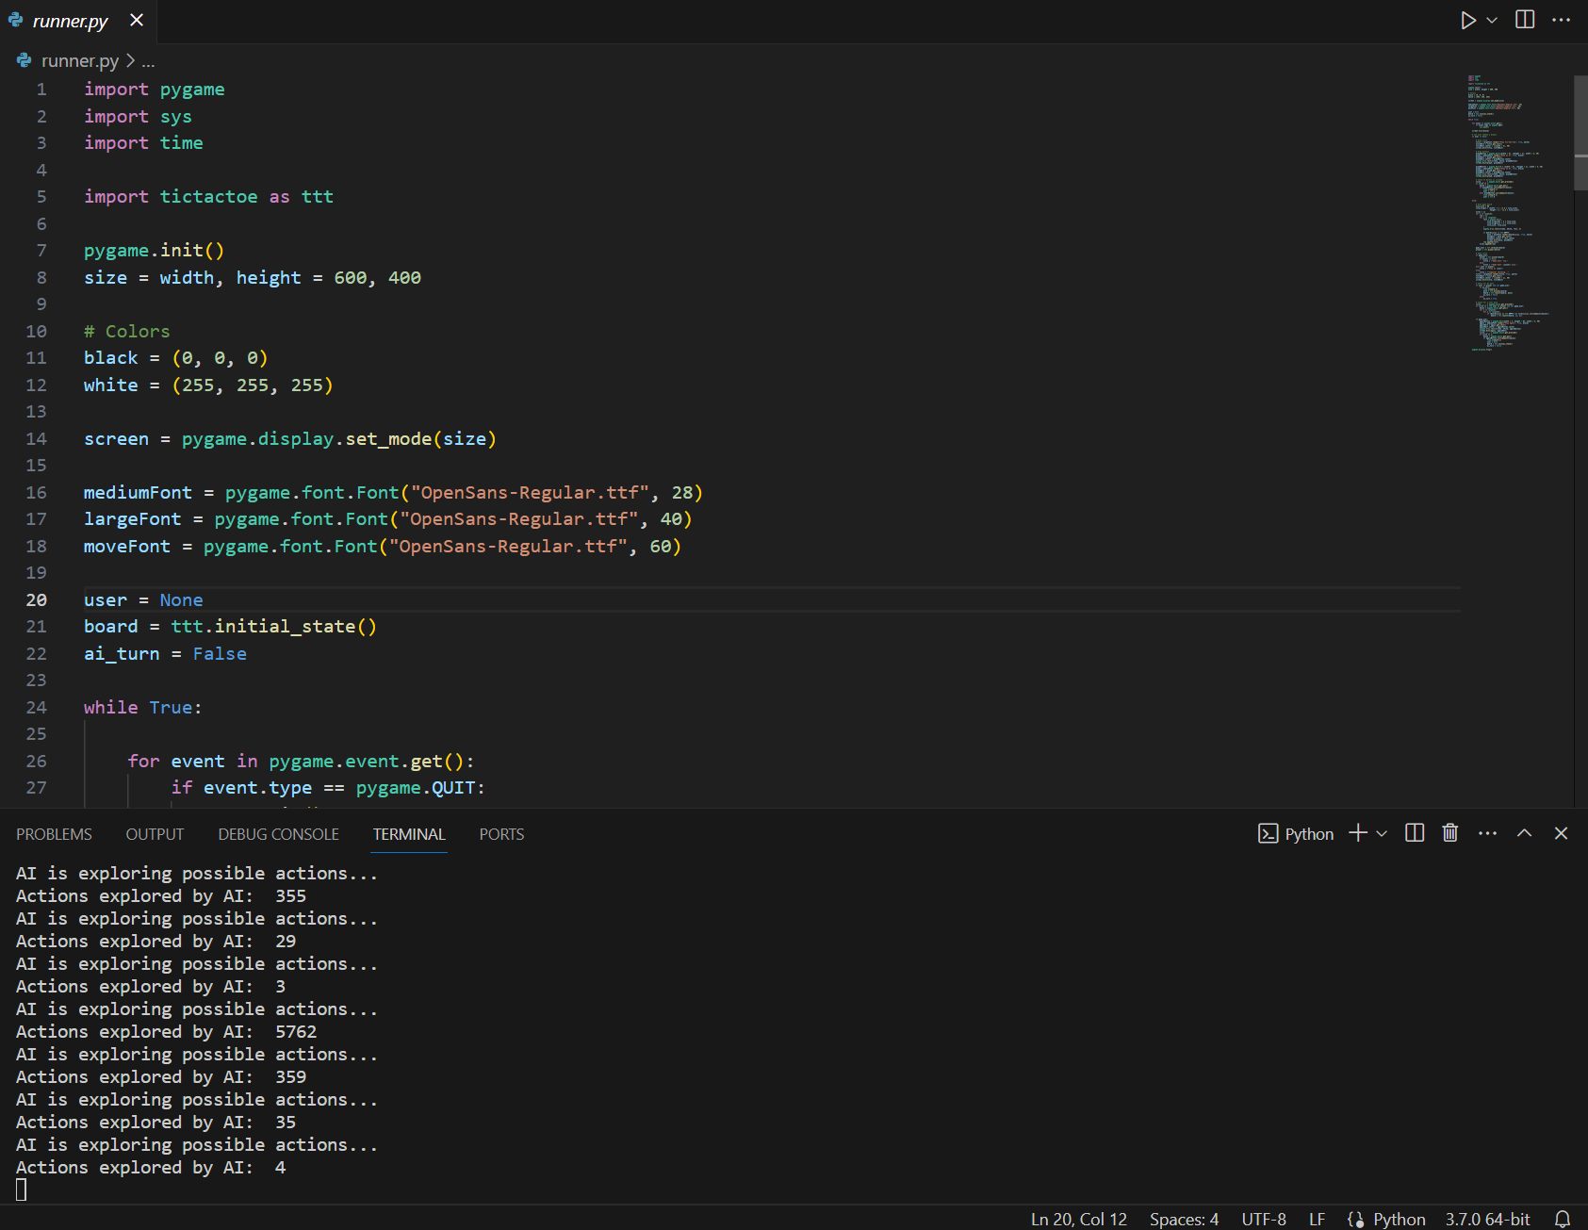
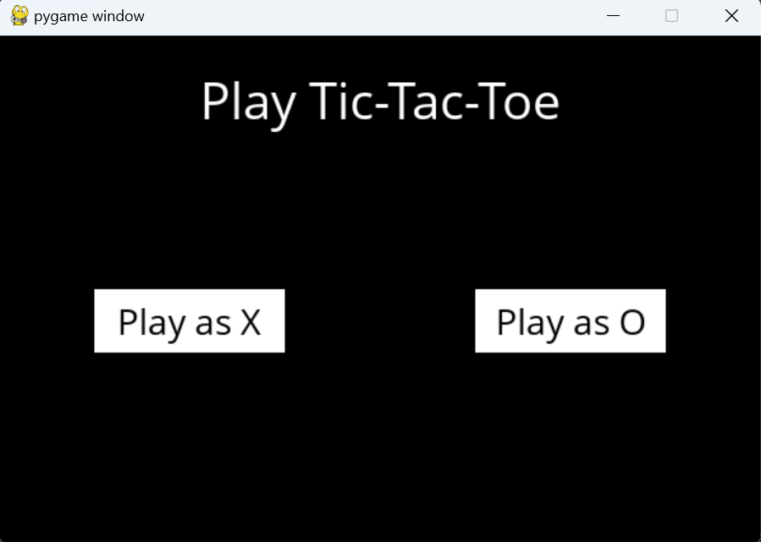
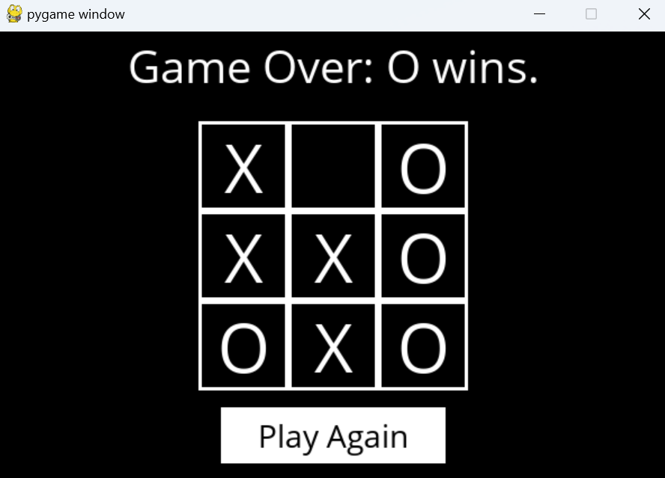
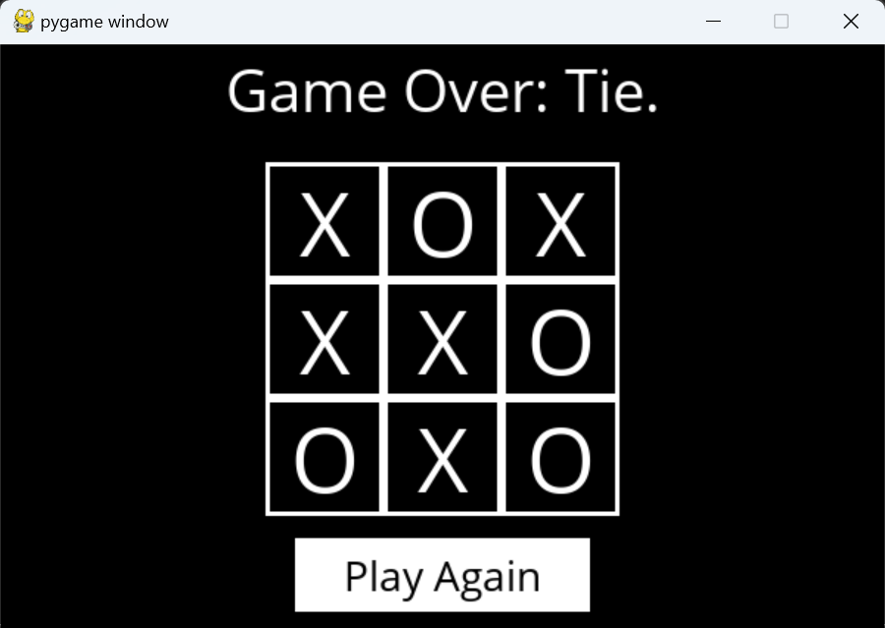
Results

Slide 12

Thank You!

